Slide 1
Free Video Conference Tools
By Dr. Steve Hecht
Today we will go over some useful and FREE tools for interacting with students.
1. Google+ (better than Skype!) for
a. Video conferencing
b. Saving/exchanging documents
interak1. Join.me
a. Remote access to a computer for document
editing, etc.

Slide 2
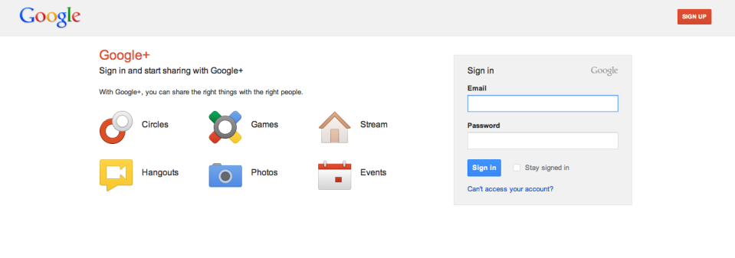
Free Video Conference Tools
By Dr. Steve Hecht
Https://accounts.google.com

Slide 3
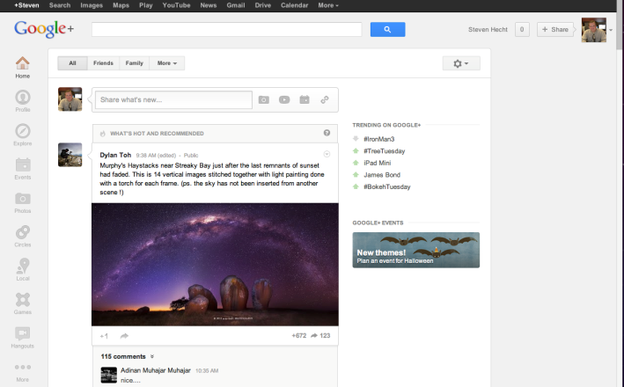
Google +
Grouping friends

Slide 4
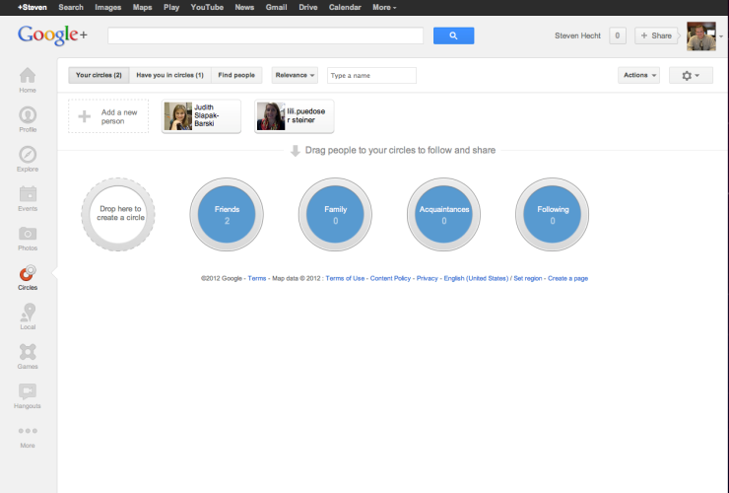
Circles of Friends

Slide 5
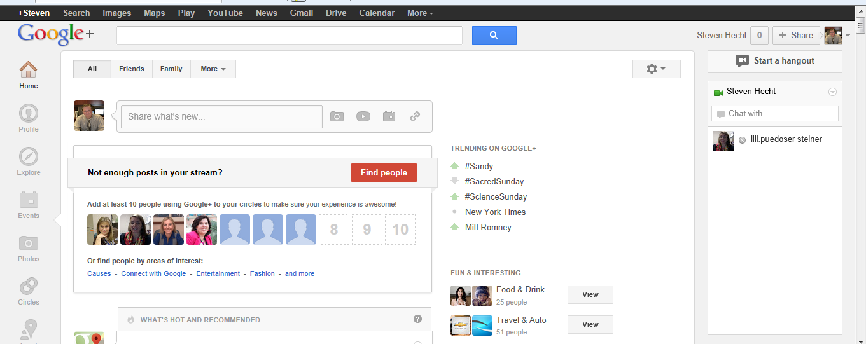
Start a Hangout
Hangout

Slide 6
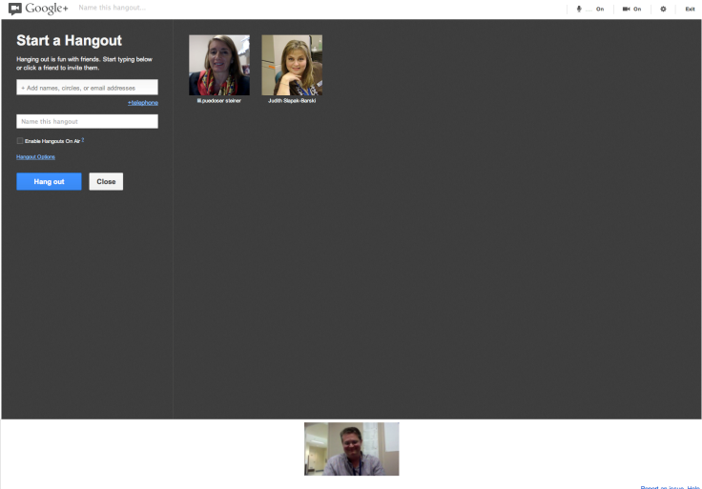
Add People in your Circles or Others With Gmail account
Someone on Telephone Could Join Meeting

Slide 7
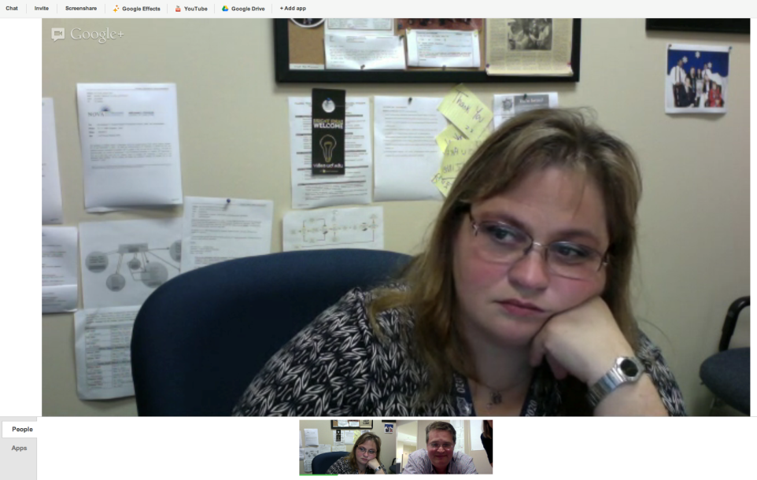

Slide 8
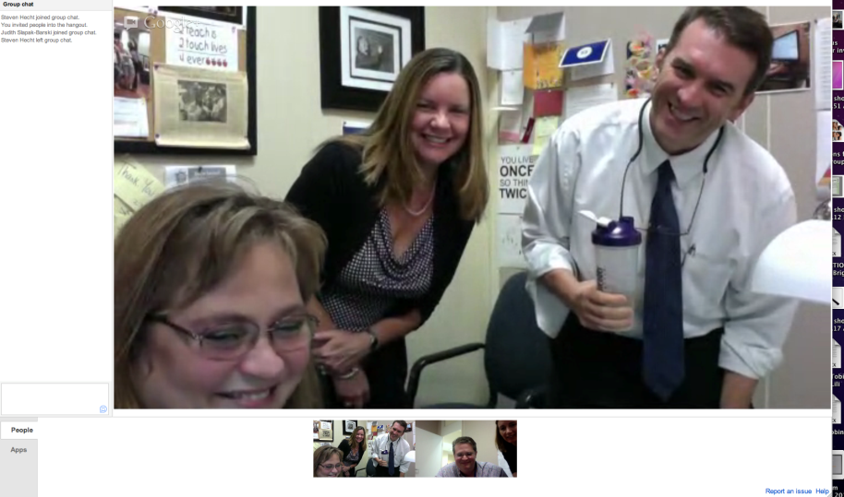

Slide 9
Screen App Can Be Viewed in Session

Slide 10
Save and Share Files with Google Drive

Slide 11
Now Let’s Turn to Join.me
Get everybody on the same page, when they're not in the same room, instantly. Review documents and designs. Join.me is a ridiculously simple screen sharing tool for meetings on the fly.

Slide 12
https://join.me/
With Join.me, users can connect to someone’s computer for
a. Providing technical assistance with
computer issues
b. Edit a document with the student
c. Providing Powerpoint presentation
d. etc.

Slide 13
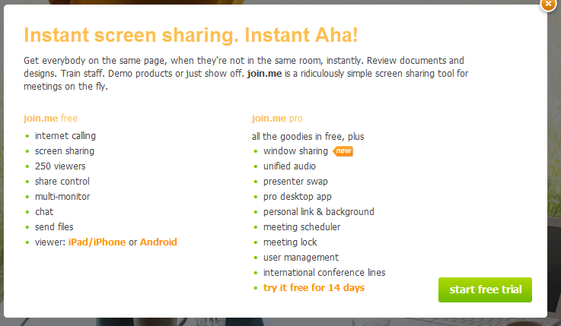
Now Let’s Turn to Join.me
By Dr. Steve Hecht

Slide 14
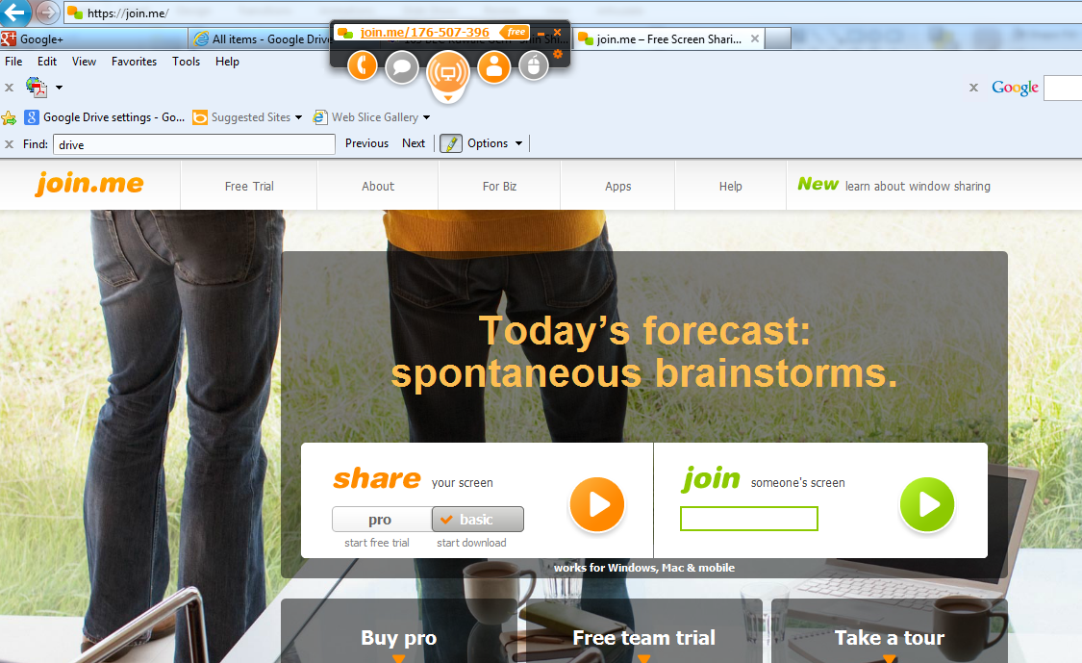
https://join.me/
9-digit number is used so that others can join into your conference

Slide 15
https://join.me/
Both voice and chat allow users to communicate during session.

Slide 16
Q &A
shecht@nova.edu
Tel. 954 262 8468

